Slide 1
Chakrai — Investor Deck
An AI Therapeutic Ecosystem for Predictive Mental Health

Slide 2
Problem & Opportunity
• Mental health access is fragmented; demand outpaces human clinician supply.
• Consumers want immediate, personalized support that respects privacy.
• Providers need scalable tools for assessment, monitoring, and outcomes.
Chakrai: AI-native, clinically-informed platform delivering continuous support,
predictive insights, and therapist augmentation at consumer scale.

Slide 3
Product Overview
• Conversational AI therapy with memory continuity
• Journaling, mood tracking, analytics, crisis detection
• Voice-first interface (Whisper + ElevenLabs)
• Therapist portal, clinical exports, EHR-ready
• PWA architecture with privacy-first, HIPAA-aligned design

Slide 4
Why We Win — Key Differentiators
• 190-point clinical personality analysis for deep personalization
• Biometric Fusion & predictive modeling for proactive intervention
• Therapist B2B2C portal for distribution + outcomes
• Bulletproof device fingerprinting & data isolation
• Tiered pricing with clear upgrade paths (Free, Premium, Professional)

Slide 5
Market Opportunity (TAM / SAM / SOM)
• TAM: ~$10B global digital mental health market; strong double-digit CAGR.
• SAM: ~$3B US market across wellness apps, digital therapy, and telehealth.
• SOM (3-year target): $100M ARR via blended B2C + B2B2C approach.

Slide 6
Business Model — Tiered Subscriptions
• Free — Basic wellness + mood tracking
• Premium ($9.99/mo) — 190+ dimensional analysis, unlimited insights, progress tracking
• Professional ($29.99/mo) — Therapist tools, clinical exports, API & integrations
• Enterprise — White-label, SSO, integrations

Slide 7
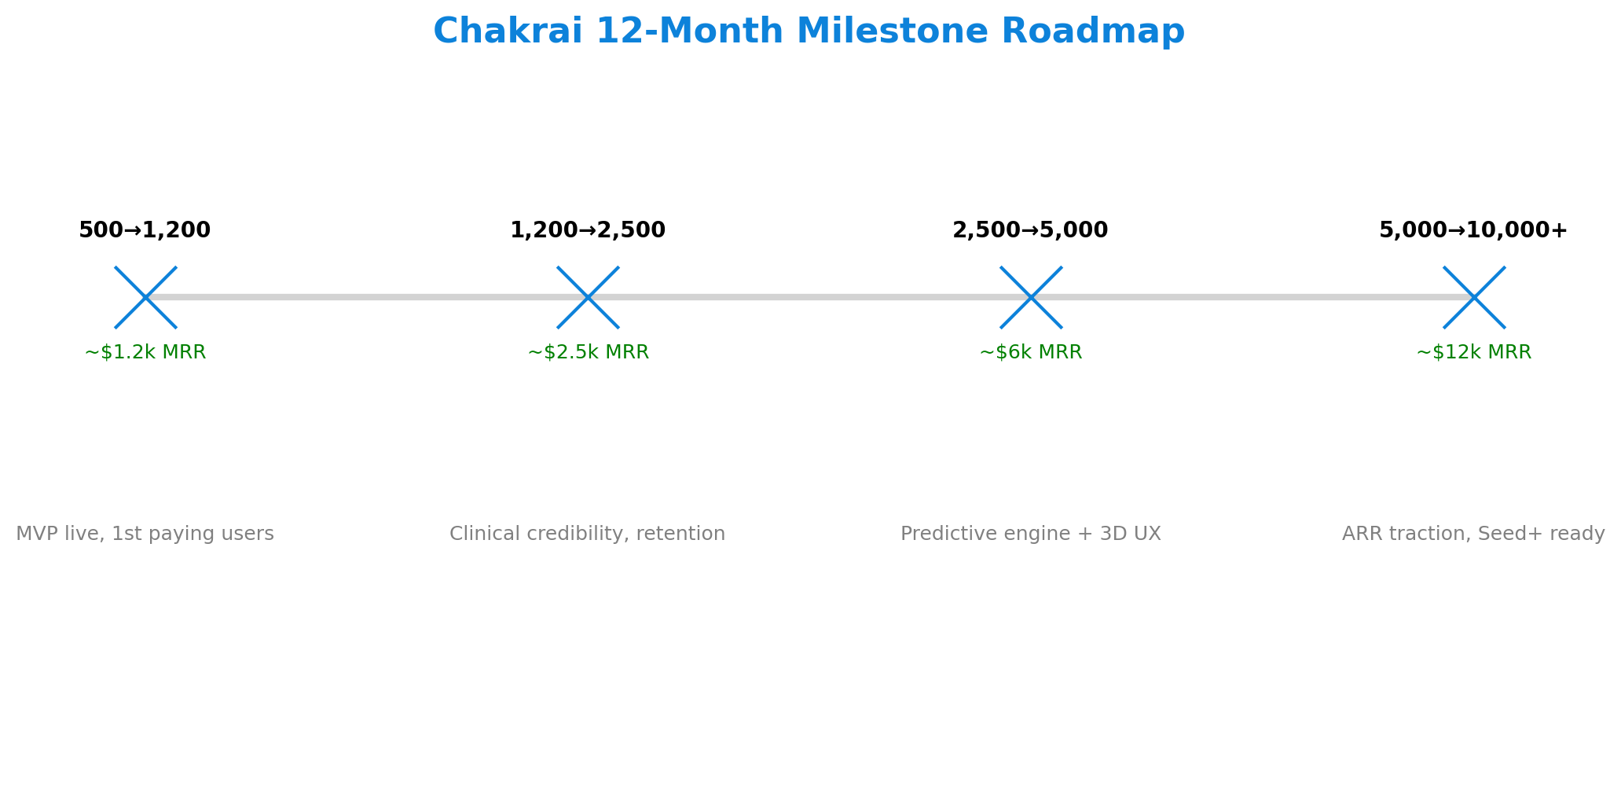
12-Month Product & Growth Roadmap

Slide 8
Financial Strategy (Year 1)
• Cumulative revenue ≈ $50k; MRR grows to ≈ $12k by Month 12
• Planned burn ≈ $41.6k/month; 12-month runway on $500k raise
• Next raise targeted Month 6–9 once traction is clear

Slide 9
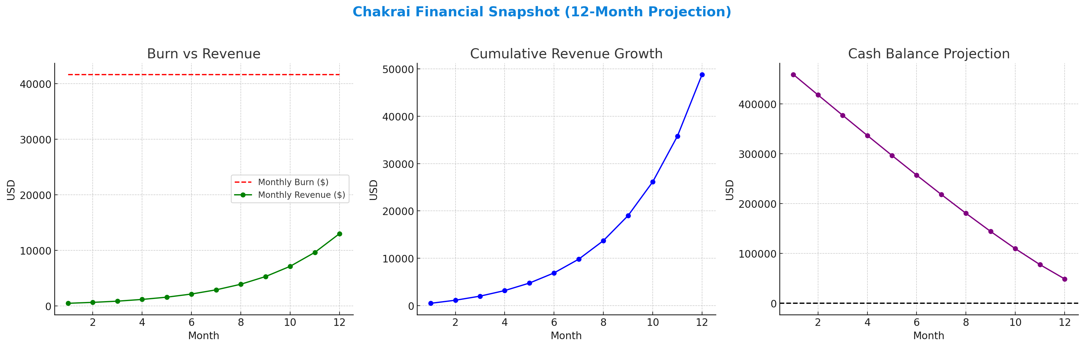
Financial Snapshot — Burn, Revenue, Runway

Slide 10
Use of Funds ($500k Seed)
• Product & Engineering — $225k (45%)
• Compliance & Security — $50k (10%)
• Cloud & Tools — $60k (12%)
• Marketing & Growth — $100k (20%)
• Ops & Admin — $40k (8%)
• Contingency — $25k (5%)

Slide 11
Go-to-Market
• B2C: App stores, influencer partnerships, community-led wellness challenges
• B2B2C: Therapist networks, employer wellness programs
• Clinical validation pilots with therapists/academic partners

Slide 12
Competitive Landscape
• Calm / Headspace — mindfulness content; limited clinical or predictive depth
• Wysa / Woebot — AI chat focus; enterprise-heavy
Chakrai: 190-point clinical analysis + biometric prediction + therapist portal + HIPAA-grade security

Slide 13
Security & Compliance
• Bulletproof device fingerprinting & user isolation
• HIPAA/GDPR-aligned architecture, auditability, encryption
• Zero data contamination by design

Slide 14
Team
Daniel Sharpe — CEO & Founder: A seasoned product and engineering leader. Daniel holds an M.S. in Computer Science.
Advisory Board: Chakrai will be assembling an advisory board of leading clinical psychologists, digital health experts, and regulatory specialists. The advisory board will guide clinical validation, regulatory strategy, and product-market ﬁt. Additional advisors are in discussions, with a focus on expanding clinical and operational expertise. Chakrai’s lean, AI-augmented operating model allows for rapid, cost-effective scaling—combining deep domain expertise with advanced engineering and clinical partnerships

Slide 15
The Ask & Terms
• Raise: $500k seed (minimum close $250k)
• Use: Ship Chakrai 2.0, biometric prediction, therapist pilots, early ARR
• Target valuation range: $5–8M post-money for 6–10% equity
• Minimum check: $25k

Slide 16
Contact
Daniel Sharpe — daniel@yobot.bot
Scottsdale, AZ

